Slide 1
Database System
Lecture 2
Database System Concepts and Architecture
Chapter 2
Alina Arshad
alina.arshad@nu.edu.pk

Slide 2
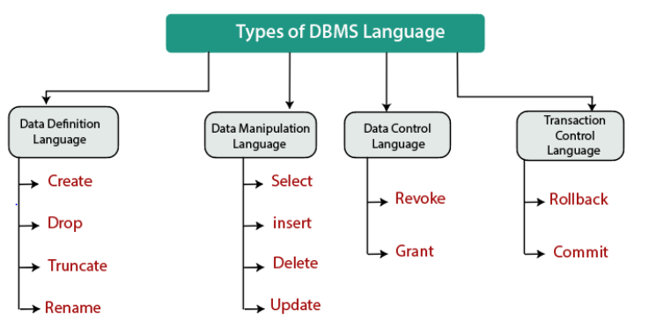
DBMS Languages

Slide 3
DBMS Languages
Data definition language (DDL):
Used by the DBA and by database designers to define conceptual and internal schemas.
DBMS DDL compiler: process DDL statements in order to identify descriptions of the schema constructs and to store the schema description in the DBMS catalog.
Tasks of DDL: Create, Alter, Drop , Truncate, Rename.
Notes:
The DBMS must provide appropriate languages and interfaces for each category of users. In this section we discuss the types of languages and interfaces provided by a DBMS and the user categories targeted by each interface.
In DBMSs where a clear separation is maintained between the conceptual and internal levels, the DDL is used to specify the conceptual schema only. Another language, the storage definition language (SDL), is used to specify the internal
schema. The mappings between the two schemas may be specified in either one of these languages. In most relational DBMSs today, there is no specific language that performs the role of SDL.
In most relational DBMSs today, there is no specific language that performs the role of SDL. Instead, the internal schema is specified by a combination of functions, parameters, and specifications related to storage of files. These permit the DBA staff to control indexing choices and mapping of data to storage. For a true three-schema architecture, we would need a third language, the view definition language (VDL), o specify user views and their mappings to the conceptual schema, but in most DBMSs the DDL is used to define both conceptual and external schemas. In relational DBMSs, SQL is used in the role of VDL to define user or application views as results of predefined queries.

Slide 4
Data definition language (DDL)
CREATE TABLE employees (
id INT PRIMARY KEY,
name VARCHAR(50),
department VARCHAR(50)
);

Slide 5
DBMS Languages
Data Manipulation Language (DML)
High-Level or Non-procedural Languages: These include the relational language SQL
May be used in a standalone way or may be embedded in a programming language
Low Level or Procedural Languages:
These must be embedded in a programming language

Slide 6
Data Manipulation Language (DML)
High-Level DML (Non-procedural):
Example: SQL’s SELECT * FROM employees WHERE department = 'Sales'; retrieves all employees in the Sales department without specifying how to access the data.
Low-Level DML (Procedural):
Example: A loop in C or Java might retrieve and process records one by one using embedded SQL commands.
INSERT INTO employees (id, name, department) VALUES (1, 'John Doe', 'HR');

Slide 7
DBMS Languages
Data manipulation language(DML) / Data sublanguage
For manipulating data, manipulations include retrieval, insertion, deletion, and modification of the data.
High-level or Nonprocedural DML:
Set-at-a-time or set-oriented: many records in a single DML statement.
SQL is a High Level DML specifies which data to retrieve not how to retrieve it. Also called Declarative Languages.
Low-level or Procedural DML
Record-at-a-time: use programming language constructs, such as looping, to retrieve and process each record from a set of records.
Programming languages used to write programs and access databases using DML statements are called host language: i.e. C++, java, python etc.
Notes:
Whenever DML commands, whether high level or low level, are embedded in a general-purpose programming language, that language is called the host language and the DML is called the data sublanguage. On the other hand, a high-level DML used in a standalone interactive manner is called a query language. In general, both retrieval and update commands of a high-level DML may be used interactively and are hence considered part of the query language.
Casual end users typically use a high-level query language to specify their requests, whereas programmers use the DML in its embedded form. For naive and parametric users, there usually are user-friendly interfaces for interacting with the database; these can also be used by casual users or others who do not want to learn the details of a high-level query language.

Slide 8
DBMS Languages
DCL(Data Control Language):
Deals with rights, permissions and other controls of the database system. i.e. GRANT, REVOKE
GRANT SELECT, UPDATE ON employees TO hr_manager;
REVOKE UPDATE ON employees FROM hr_manager;
GRANT: Gives specific privileges to users.
REVOKE: Removes previously granted privileges.
Notes:
Grant get access revoke mean no access

Slide 9
DBMS Languages
TCL(transaction Control Language): deals with the transaction within the database. i.e. COMMIT, ROLLBACK, SAVEPOINT
COMMIT: Saves all changes made during the current transaction.
ROLLBACK: Reverts the database to its state before the current transaction began, undoing any changes made.
SAVEPOINT: Sets a point within a transaction to which you can later roll back.

Slide 10
TCL(transaction Control Language):
Example Scenario: Suppose you’re updating the accounts table in a bank database. You transfer money from one account to another, which involves multiple steps (debit one account, credit another). You want to ensure that both operations succeed or none at all.
BEGIN TRANSACTION;
UPDATE accounts SET balance = balance - 100 WHERE account_id = 1;
UPDATE accounts SET balance = balance + 100 WHERE account_id = 2;
COMMIT;
UPDATE accounts SET balance = balance - 100 WHERE account_id = 1;
UPDATE accounts SET balance = balance + 100 WHERE account_id = 2;
ROLLBACK;
SAVEPOINT before_update;
UPDATE accounts SET balance = balance - 100 WHERE account_id = 1;
-- Suppose something goes wrong here
ROLLBACK TO before_update;

Slide 11
DBMS Languages
Storage definition language (SDL): SDL is used to specify the internal schema. This component is removed from current SQL to keep it conceptual and external level only.
*Used to define how data is stored internally.
View definition language (VDL): to specify user views and their mappings to the conceptual schema.
In most DBMSs the DDL is used to define both conceptual and external schemas.
Notes:
Once the database schemas are compiled and the database is populated with data, users must have some means to manipulate the database. Typical manipulations include retrieval, insertion, deletion, and modification of the data. The DBMS provides a set of operations or a language called the data manipulation language (DML) for these purposes.
In current DBMSs, the preceding types of languages are usually not considered distinct languages; rather, a comprehensive integrated language is used that includes constructs for conceptual schema definition, view definition, and data manipulation. Storage definition is typically kept separate, since it is used for defining physical storage structures to fine-tune the performance of the database system, which is usually done by the DBA staff. A typical example of a comprehensive database language is the SQL relational database language, which represents a combination of DDL, VDL, and DML, as well as statements for constraint specification, schema evolution, and many other features. The SDL was a component in early versions of SQL but has been removed from the language to keep it at the conceptual and external levels only.
The SDL was a component in early versions of SQL but has been removed from the language to keep it at the conceptual and external levels only.

Slide 12
DBMS Programming Language Interfaces
Programmer interfaces for embedding DML in a programming languages:
Embedded Approach: e.g embedded SQL (for C, C++, etc.), SQLJ (for Java)
Procedure Call Approach: e.g. JDBC(Java database connectivity for Java, ODBC (Open Database Connectivity) for other programming languages as API’s (application programming interfaces)
Database Programming Language Approach: e.g. ORACLE has PL/SQL, a programming language based on SQL; language incorporates SQL and its data types as integral components
Scripting Languages: PHP (client-side scripting) and Python (server-side scripting) are used to write database programs.

Slide 13
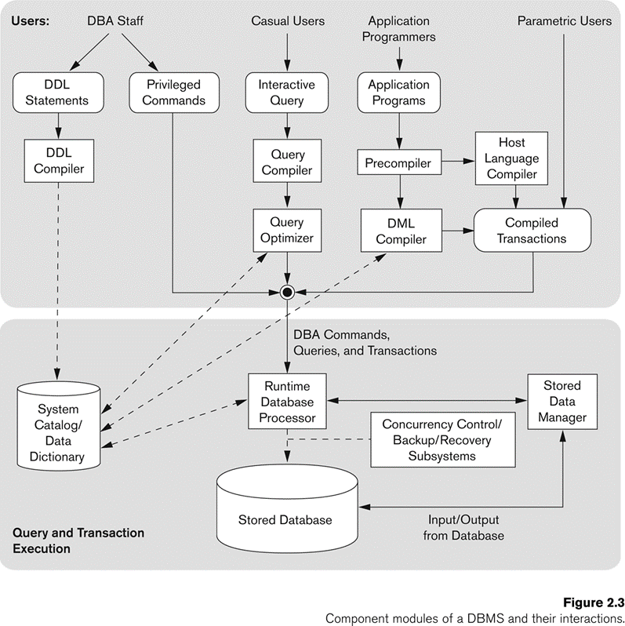
The Database System Environment
Users of database environment and their interfaces
internal modules of the DBMS responsible for storage of data and processing of transactions

Slide 14
DBMS Interfaces
Menu-based Interfaces for Web Clients or Browsing
Apps for Mobile Devices: allow users to access their data through a mobile phone.
For example, banking, reservations etc.
Forms-based Interfaces: designed and programmed for naive users as interfaces to canned transactions.
Graphical User Interfaces: displays a schema to the user in diagrammatic form.
The user then can specify a query by manipulating the diagram.
GUIs utilize both menus and forms.
Notes:
Menu-based Interfaces for Web Clients or Browsing
User-friendly interfaces provided by a DBMS may include the following: Menu-based Interfaces for Web Clients or Browsing. These interfaces present the user with lists of options (called menus) that lead the user through the formulation of a request. Menus do away with the need to memorize the specific commands and syntax of a query language; rather, the query is composed step-bystep by picking options from a menu that is displayed by the system. Pull-down menus are a very popular technique in Web-based user interfaces. They are also often used in browsing interfaces, which allow a user to look through the contents of a database in an exploratory and unstructured manner.
Apps for Mobile Devices. These interfaces present mobile users with access to their data. For example, banking, reservations, and insurance companies, among many others, provide apps that allow users to access their data through a mobile phone or mobile device. The apps have built-in programmed interfaces that typically allow users to login using their account name and password; the apps then provide a limited menu of options for mobile access to the user data, as well as options such as paying bills (for banks) or making reservations (for reservation Web sites).
Forms-based Interfaces. A forms-based interface displays a form to each user. Users can fill out all of the form entries to insert new data, or they can fill out only certain entries, in which case the DBMS will retrieve matching data for the remaining entries. Forms are usually designed and programmed for naive users as interfaces to canned transactions. Many DBMSs have forms specification languages, which are special languages that help programmers specify such forms. SQL*Forms is a form-based language that specifies queries using a form designed in conjunction with the relational database schema. Oracle Forms is a component of the Oracle product suite that provides an extensive set of features to design and build applications using forms. Some systems have utilities that define a form by letting the end user interactively construct a sample form on the screen.
Graphical User Interfaces. A GUI typically displays a schema to the user in diagrammatic form. The user then can specify a query by manipulating the diagram. In many cases, GUIs utilize both menus and forms.

Slide 15
DBMS Interfaces
Natural Language Interfaces: These interfaces accept requests written in English or some other language and attempt to understand them.
Has its own schema similar to the database conceptual schema, as well as a dictionary of important words.
It refers to the words in its schema, as well as to the set of standard words in its dictionary, that are used to interpret the request.
If the interpretation is successful, the interface generates a high-level query corresponding to the natural language request and submits it to the DBMS for processing;
otherwise, a dialogue is started with the user to clarify the request.
Notes:
Natural Language Interfaces. These interfaces accept requests written in English or some other language and attempt to understand them. A natural language interface usually has its own schema, which is similar to the database conceptual schema, as well as a dictionary of important words. The natural language interface refers to the words in its schema, as well as to the set of standard words in its dictionary, that are used to interpret the request. If the interpretation is successful, the interface generates a high-level query corresponding to the natural language request and submits it to the DBMS for processing; otherwise, a dialogue is started with the user to clarify the request.
When you ask a question like, "Show me all employees in the Sales department," the interface tries to match your words with its schema and dictionary.

Slide 16
DBMS Interfaces
Keyword-based Database Search: similar to Web search engines, which accept strings of natural language words and match them with documents at specific sites (for local search engines) or Web pages on the Web at large (for engines like Google).
Use predefined indexes on words and use ranking functions to retrieve and present resulting documents in a decreasing degree of match.
Speech Input and Output. Limited use of speech as an input query and speech as an answer to a question of a request.
i.e. inquiries for telephone directory, flight arrival/departure, and credit card account information.
The speech input is detected using a library of predefined words and used to set up the parameters that are supplied to the queries.
For output, a similar conversion from text or numbers into speech takes place.
Notes:
Keyword-based Database Search. These are somewhat similar to Web search engines, which accept strings of natural language (like English or Spanish) words and match them with documents at specific sites (for local search engines) or Web pages on the Web at large (for engines like Google or Ask). They use predefined indexes on words and use ranking functions to retrieve and present resulting documents in a decreasing degree of match. Such “free form” textual query interfaces are not yet common in structured relational databases, although a research area called keyword-based querying has emerged recently for relational databases.
Speech Input and Output. Limited use of speech as an input query and speech as an answer to a question or result of a request is becoming commonplace. Applications with limited vocabularies, such as inquiries for telephone directory, flight arrival/departure, and credit card account information, are allowing speech for input and output to enable customers to access this information. The speech input is detected using a library of predefined words and used to set up the parameters that are supplied to the queries. For output, a similar conversion from text or numbers into speech takes place.

Slide 17
DBMS Interfaces
Interfaces for Parametric Users: Parametric users, such as bank tellers.
repetitive transactions such as account deposits or withdrawals, or balance inquiries.
Interfaces for the DBA: privileged commands that can be used only by the DBA staff.
commands for creating accounts
setting system parameters
granting account authorization
changing a schema
reorganizing the storage structures of a database.
Notes:
Interfaces for Parametric Users(who don't have any DBMS knowledge). Parametric users, such as bank tellers, often have a small set of operations that they must perform repeatedly. For example, a teller is able to use single function keys to invoke routine and repetitive transactions such as account deposits or withdrawals, or balance inquiries. Systems analysts and programmers design and implement a special interface for each known class of naive users. Usually a small set of abbreviated commands is included, with the goal of minimizing the number of keystrokes required for each request.
Interfaces for the DBA. Most database systems contain privileged commands that can be used only by the DBA staff. These include commands for creating accounts, setting system parameters, granting account authorization, changing a schema, and reorganizing the storage structures of a database.

Slide 18
Any question????

